Slide 1
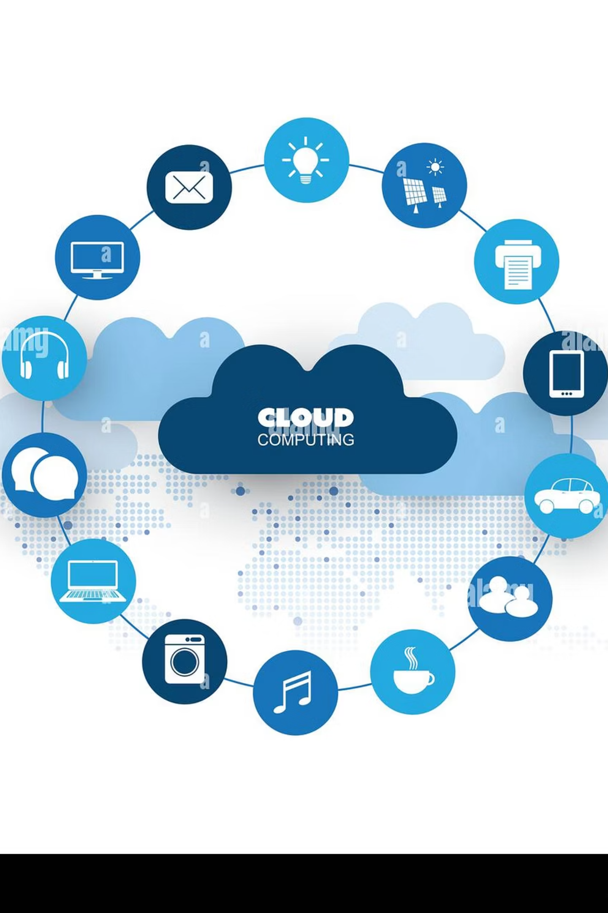
AWS Messaging Services: Amazon SQS vs Amazon MQ
Choosing the right messaging service is crucial for building scalable, resilient, and loosely coupled applications in the cloud. This presentation explores the capabilities of Amazon Simple Queue Service (SQS) and Amazon MQ, helping you determine which service best fits your architectural needs.

Slide 2
Why Messaging Matters in Cloud Architectures
In today's complex cloud environments, inter-service communication can quickly become a bottleneck. Messaging services act as a vital intermediary, enabling systems to interact efficiently and reliably.
1
2
Decoupling Microservices & Distributed Systems
Enabling Asynchronous Communication
Messaging queues allow different components of an application to operate independently without direct dependencies. This architectural pattern enhances scalability, as services can be scaled up or down asynchronously, and improves reliability by preventing failures in one component from cascading across the entire system. It's like having a central post office for all your application's letters, ensuring each message gets to its destination even if the recipient is temporarily unavailable.
By enabling asynchronous communication, messaging services significantly improve fault tolerance and performance. Instead of waiting for a direct response, a service can simply send a message to a queue and continue its processing, improving overall system responsiveness. This is particularly critical for long-running tasks or processes that involve multiple steps, where immediate synchronous responses are not required. For example, an e-commerce order processing system can place an order in a queue and immediately confirm receipt to the customer, while the actual fulfillment processes happen in the background.

Slide 3
What is Amazon SQS?
Amazon Simple Queue Service (SQS) is a fully managed message queuing service that enables you to decouple and scale microservices, distributed systems, and serverless applications. SQS eliminates the complexity associated with managing and operating message-oriented middleware, allowing developers to focus on application logic rather than infrastructure.
Fully Managed: AWS handles all the operational heavy lifting, including provisioning, patching, and scaling. You don't need to manage servers or infrastructure.
Highly Scalable: SQS scales automatically to handle any volume of messages, from a few to hundreds of thousands per second, without any upfront capacity planning.
Queue Types:
Standard Queues: Offer maximum throughput, best-effort ordering, and at-least-once delivery. Ideal for scenarios where duplicate messages or out-of-order messages are acceptable (e.g., event notifications, work queues).
FIFO (First-In-First-Out) Queues: Ensure that messages are processed exactly once, in the exact order that they are sent. Perfect for situations where the order of operations and preventing duplicates is critical (e.g., financial transactions, inventory updates).
Built-in Features: SQS handles message storage, configurable visibility timeouts (to prevent multiple consumers from processing the same message), dead-letter queues (for messages that can't be processed), and offers encryption at rest using AWS Key Management Service (KMS).

Slide 4
Amazon SQS: Key Benefits & Features
Effortless Scalability
Robust Security
SQS is designed for infinite scaling. It automatically expands or contracts its capacity to meet demand, meaning you never have to provision servers or worry about throughput limits. This elasticity ensures your application can handle sudden spikes in traffic without performance degradation or manual intervention, making it ideal for event-driven architectures and microservices that experience variable loads.
Security is paramount, and SQS offers comprehensive features to protect your data. This includes server-side encryption with AWS Key Management Service (KMS) for data at rest, and fine-grained access control through AWS Identity and Access Management (IAM) policies. You can control exactly who can send and receive messages, ensuring only authorized entities interact with your queues.
Seamless AWS Integration
Cost-Effective Pricing
SQS deeply integrates with other AWS services, simplifying your architecture. It can serve as a native event source for AWS Lambda, allowing you to build serverless workflows. Monitoring is readily available through Amazon CloudWatch, providing metrics and logs for your queues. Additionally, comprehensive SDK support across multiple programming languages makes it easy to integrate SQS into your existing applications.
SQS operates on a pay-as-you-go model, meaning you only incur costs for the messages you send and receive. There are no upfront fees, minimum commitments, or charges for idle queues. This makes SQS highly cost-efficient, especially for applications with fluctuating workloads, as you only pay for the actual resources consumed.

Slide 5
What is Amazon MQ?
Amazon MQ is a managed message broker service for Apache ActiveMQ Classic and RabbitMQ that makes it easy to set up and operate message brokers in the cloud. It is particularly well-suited for applications that rely on industry-standard messaging APIs and protocols, or those migrating from on-premises message brokers.
Managed Service: Amazon MQ takes care of the administrative burden of managing message brokers, including provisioning infrastructure, software upgrades, patching, and backups. This reduces operational overhead and allows you to focus on application development.
Broker Compatibility: It supports widely used open-source message brokers:
Apache ActiveMQ Classic: A popular, robust open-source message broker.
RabbitMQ: Another highly popular and feature-rich message broker known for its flexibility.
Simplified Migration: Amazon MQ is designed to simplify the migration of existing applications that use ActiveMQ or RabbitMQ from on-premises to the cloud. Since it supports the same APIs and protocols, you can often migrate your applications with minimal to no code changes.
Industry-Standard Protocols: Amazon MQ supports a wide array of industry-standard messaging protocols, ensuring broad compatibility with diverse applications:
AMQP (Advanced Message Queuing Protocol): A robust, open-source messaging protocol.
MQTT (Message Queuing Telemetry Transport): Lightweight protocol for IoT and mobile applications.
JMS (Java Message Service): A Java API for messaging middleware.
OpenWire, STOMP, WSS, and more: Providing flexibility for various client applications.

Slide 6
Amazon MQ: Key Benefits & Features
Automated Broker Management
High Availability & Resilience
Amazon MQ handles routine broker management tasks such as provisioning, security updates, and daily backups. It also offers automated version upgrades, ensuring your brokers are always running on the latest stable software without manual intervention. Integration with Amazon CloudWatch provides comprehensive monitoring of broker metrics and logs, giving you deep visibility into performance and operational health.
For critical workloads, Amazon MQ supports high availability deployments. You can configure brokers across multiple Availability Zones (Multi-AZ) within a region, providing automatic failover and data replication. Active/standby configurations for ActiveMQ and quorum-based clustering for RabbitMQ ensure continuous operation. Cross-region replication further enhances disaster recovery capabilities for ultimate resilience.
Enhanced Security
Advanced Messaging Patterns & Legacy Support
Security features include encryption for messages in transit (SSL/TLS) and at rest (KMS). Access to brokers can be controlled using AWS IAM policies, allowing fine-grained permissions. Furthermore, Amazon MQ brokers can be launched within your Amazon Virtual Private Cloud (VPC), providing private network connectivity and isolation from the public internet, enhancing data security and compliance.
Amazon MQ excels in scenarios requiring advanced messaging patterns beyond simple queues, such as publish/subscribe (topics), message routing, and message filtering, which are inherent to ActiveMQ and RabbitMQ. Its compatibility with legacy protocols makes it the ideal choice for migrating existing enterprise applications without significant code rewrites, ensuring a smoother transition to the cloud.

Slide 7


SQS vs MQ: When to Use Which?
Choosing between Amazon SQS and Amazon MQ depends heavily on your specific application requirements, existing infrastructure, and desired operational model. Both services aim to facilitate decoupling but approach the problem from different angles.
Use Amazon SQS For:
Use Amazon MQ For:
New Cloud-Native Applications: When building new applications from scratch on AWS, especially those adopting microservices or serverless architectures. SQS's simplicity and direct integration with Lambda make it a natural fit.
Migrating Legacy Applications: When you have existing applications built on Apache ActiveMQ Classic or RabbitMQ that you want to move to the cloud with minimal code changes. Amazon MQ supports the same open-standard APIs and protocols.
Simple, Scalable Queues: If your primary need is a highly scalable, reliable queue that can handle massive throughput without the complexities of managing a full-fledged message broker.
Requiring Advanced Broker Features: If your application requires complex messaging patterns like publish/subscribe topics, message routing, message filtering, or request-response paradigms that are inherent to traditional message brokers.
Serverless Integration: SQS is the preferred choice for serverless workflows, where messages trigger AWS Lambda functions, as it's designed to seamlessly integrate with the serverless ecosystem.
Protocol Compatibility: If your application or existing third-party systems depend on specific protocols like AMQP, MQTT, JMS, or STOMP that SQS does not natively support.
Cost Efficiency: Its pay-per-message model makes it extremely cost-effective for variable workloads or large-scale, asynchronous tasks.
Enterprise Standard Consistency: For organizations that have standardized on ActiveMQ or RabbitMQ across their enterprise and want to maintain operational consistency across on-premises and cloud environments.

Slide 8
Real-World Integration Example
A common challenge for enterprises is integrating their existing on-premises systems with new cloud-based applications. Consider a scenario involving a large financial institution with mission-critical applications relying on on-premises IBM MQ, needing to integrate with a new fraud detection service hosted on AWS using modern serverless components.
Bi-directional Bridge with Apache Camel: To facilitate seamless communication, an Apache Camel-based integration layer can be deployed. Apache Camel is an open-source integration framework that allows you to integrate various systems using routing and mediation rules.
IBM MQ to AWS Integration: Apache Camel can act as a bridge, consuming messages from on-premises IBM MQ queues and routing them to AWS.
Flexible AWS Destinations:
Amazon MQ (ActiveMQ): For complex routing or if the IBM MQ messages require transformation into a format consumable by other enterprise systems already using ActiveMQ.
Amazon SQS: For simpler, high-volume message passing, especially if the messages will directly trigger AWS Lambda functions for fraud analysis.
Amazon SNS (Simple Notification Service): To publish messages as topics for fanout to multiple subscribers (e.g., SQS queues, Lambda, email).
Large Message Handling: If messages exceed SQS's or MQ's size limits, the integration layer can use S3-backed storage. The message payload is stored in Amazon S3, and only a pointer (S3 URI) is passed through the messaging service.
Dead-Letter Queues (DLQ): Both Amazon MQ and SQS support DLQs. Messages that fail processing after a configured number of retries are moved to a DLQ for inspection and reprocessing, ensuring no message is lost. This is crucial for maintaining data integrity in financial systems.
This hybrid approach leverages Amazon MQ's compatibility with traditional brokers and SQS's cloud-native scaling, allowing for a phased migration and robust cross-environment communication.

Slide 9
Architectural Patterns with SQS & MQ
Both Amazon SQS and Amazon MQ are fundamental building blocks for designing scalable, resilient, and event-driven architectures in AWS. They enable various patterns to achieve specific operational and business goals.
01
02
03
Fanout Pattern with SNS & SQS
Event-Driven Serverless with SQS & Lambda
Hybrid Migration with Amazon MQ
This pattern uses Amazon SNS (Simple Notification Service) as a central message hub to publish a message once, and then fan it out to multiple Amazon SQS queues. Each SQS queue can then trigger a different downstream service (e.g., Lambda functions for analytics, email notifications, database updates). This ensures parallel processing and decoupling of producers from multiple consumers, enabling highly scalable and decoupled event-driven systems for scenarios like e-commerce order processing, where one event (order placed) needs to notify multiple services (payment, shipping, inventory).
For organizations with significant investments in on-premises message brokers, Amazon MQ facilitates a gradual, hybrid migration strategy. Existing applications can continue to use their familiar messaging APIs (JMS, AMQP) and protocols, while the underlying broker infrastructure is shifted to the managed Amazon MQ service in the cloud. This allows for minimal downtime and code changes during the transition, enabling a smoother path to cloud adoption for enterprise applications.
SQS is a common trigger for AWS Lambda functions, forming a core component of event-driven serverless architectures. Messages placed in an SQS queue automatically invoke a Lambda function. This pattern is ideal for handling asynchronous background tasks like image processing, data transformations, or report generation. It allows your application to scale compute resources based on the queue backlog, processing events efficiently and cost-effectively without provisioning servers.

Slide 10
Conclusion: Choosing the Right AWS Messaging Service
The decision between Amazon SQS and Amazon MQ ultimately depends on your specific use case, the nature of your application, and your existing technology stack.
Amazon SQS: Is the lightweight, fully managed, and highly scalable message queuing service designed for modern cloud-native applications. It is ideal for building serverless and microservices architectures that require simple, reliable, and decoupled communication, with a focus on cost-efficiency and ease of integration within the AWS ecosystem.
Amazon MQ: Provides a managed service for traditional message brokers (ActiveMQ and RabbitMQ), making it suitable for applications that need advanced broker features, broader protocol compatibility, or are undergoing a migration from on-premises environments. It offers a "lift and shift" capability for existing messaging-centric applications.
By understanding the strengths of both services and leveraging the broader AWS integration ecosystem, you can build resilient, scalable, and secure distributed applications that meet the demands of today's dynamic cloud environments. Always consider your current infrastructure, future growth, and developer preferences when making your choice.

